Slide 1
Descriptive Statistics
Numerical Representations

Slide 2
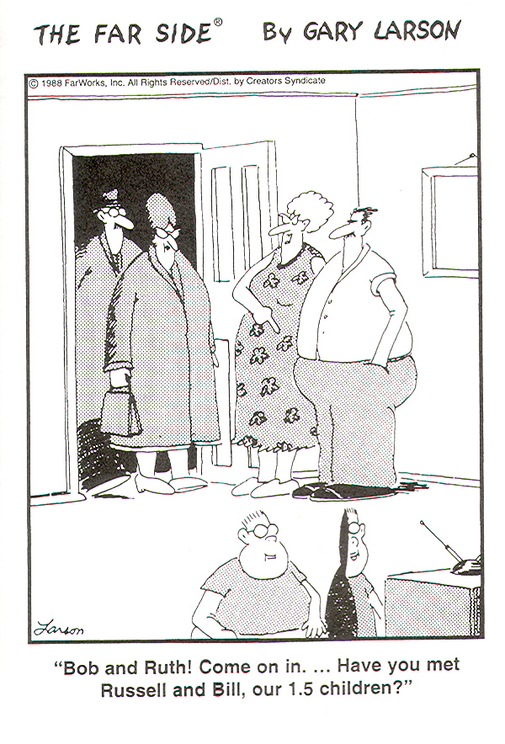
Central Tendency and Variability

Slide 3
Descriptive Statistics
The goal of descriptive statistics is to summarize a collection of data in a clear and understandable way.
What is the pattern of scores over the range of possible values?
Where, on the scale of possible scores, is a point that best represents the set of scores?
Do the scores cluster about their central point or do they spread out around it?

Slide 4
Central Tendency
Measure of Central Tendency:
A single summary score that best describes the central location of an entire distribution of scores.
The typical score.
The center of the distribution.
For Central Tendency, we will focus on learning how to calculate three measure of central tendency: mean, median, and mode (as well as their grouped versions), will discuss their use, and will discuss the relationship to levels of measurement

Slide 5
Central Tendency
Measures of Central Tendency:
Mean
The sum of all scores divided by the number of scores.
Median
The value that divides the distribution in half when observations are ordered.
Mode
The most frequent score.

Slide 6
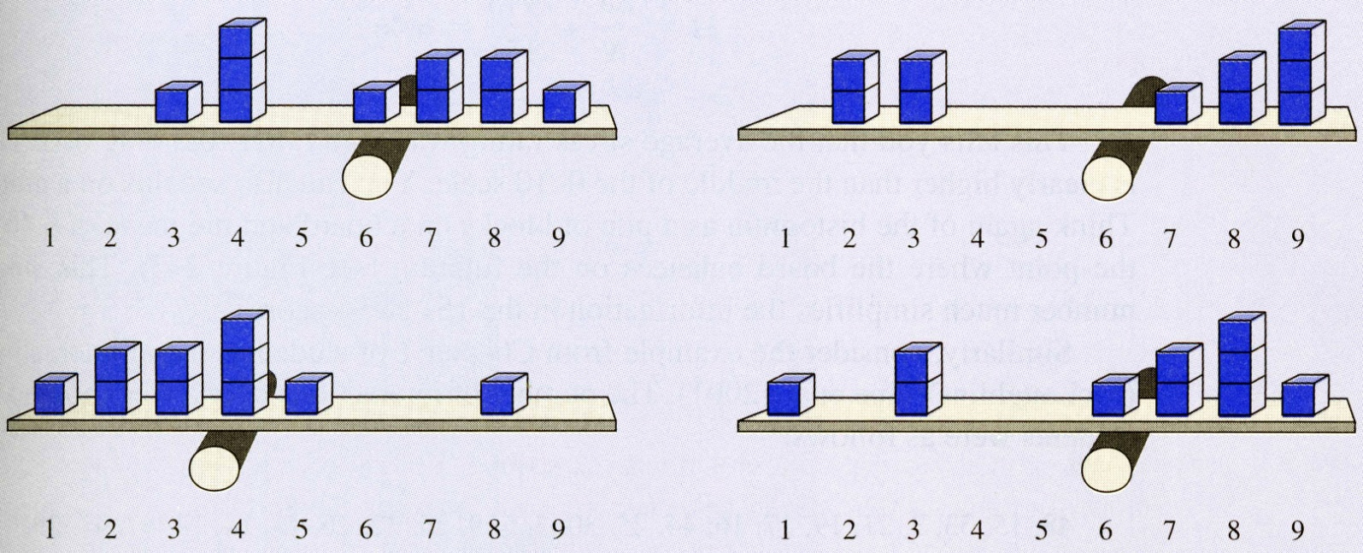
Mean
Is the balance point of a distribution.
The sum of negative deviations from the mean exactly equals the sum of positive deviations from the mean.

Slide 7
Mean
“sigma”, the sum of X, add up all scores
Population
Sample
“mu”
“N”, the total number of scores in a population
“sigma”, the sum of X, add up all scores
“X bar”
“n”, the total number of scores in a sample

Slide 8
Central Tendency Example: Mean
52, 76, 100, 136, 186, 196, 205, 250, 257, 264, 264, 280, 282, 283, 303, 313, 317, 317, 325, 373, 384, 384, 400, 402, 417, 422, 472, 480, 643, 693, 732, 749, 750, 791, 891
Mean hotel rate:
Mean hotel rate: $371.60

Slide 9
Task
The head of the Bureau of Records wants to know the mean length of government service of the employees in the bureau’s Office of Computer Support
Calculate the mean
14.75
Years of Government Service
Employee | Years | Employee | Years
Bush | 8 | Jackson | 9
Clinton | 15 | Gore | 11
Reagan | 23 | Cheney | 18
Kerry | 14 | Carter | 20

Slide 10
Task
The head of the Bureau of Records decides to create a new position in the office and hires a newly graduated MPA with a great computer background but only 1 year of prior government service
Calculate the mean of years of government service with the additional employee
13.22 (now underestimating years of government service)

Slide 11
Pros and Cons of the Mean
Pros
Mathematical center of a distribution.
Just as far from scores above it as it is from scores below it.
Good for interval and ratio data.
Does not ignore any information.
Inferential statistics is based on mathematical properties of the mean.
Cons
Influenced by extreme scores and skewed distributions.
May not exist in the data. For example, the average US family has 1.7 children, 2.2 pets, and made fiancial contributions to 3.4 charitable organizations

Slide 12
Central Tendency Example: Median
52, 76, 100, 136, 186, 196, 205, 150, 257, 264, 264, 280, 282, 283, 303, 313, 317, 317, 325, 373, 384, 384, 400, 402, 417, 422, 472, 480, 643, 693, 732, 749, 750, 791, 891
The median is the middle value when observations are ordered.
To find the middle, count in (N+1)/2 scores when observations are ordered lowest to highest.
Median hotel rate:
(35+1)/2 = 18
317

Slide 13
Finding the median with an even number of scores.
2, 2, 3, 5, 6, 7, 7, 7, 8, 9
With an even number of scores, the median is the average of the middle two observations when observations are ordered.
Find the average of the N/2 and the (N+2)/2 score.
N/2 = 5th score, (N+2)/2 = 6th score
Add middle two observations and divide by two.
(6+7)/2 = 6.5
Median is 6.5

Slide 14
Another example
The Sternville City Council requires that all city agencies include an average salary in their budget requests
The Sternville City Planning Office has seven employees
The director is paid $42,500
The assistant director is paid $39,500
The planning clerks are paid $22,600, $22,500, and $22,400
The secretary (who does all the work) is paid $17,500
The receptionist is paid $16,300
Calculate the mean
$26,186
Director doesn’t like the result – department looks fat and bloated

Slide 15
Example cont.
The secretary (who is currently taking a methods class) points out that the large salaries paid to the director and the assistant director are distorting the mean
The secretary calculates the median by:
1. Listing the salaries in order of magnitude (up or down, it doesn’t matter)
2. Locating the middle item by adding 1 to the number of items and diving by 2
What is the median?
Clerk 2 : $22,500

Slide 16
Example cont.
The planning director reports the median to the Sternville City Council
However, because of a local tax revolt, the mayor tells the director he must fire one employee anyway
Responding like a typical bureaucracy, they fire the receptionist
Now, what is the Median salary of the Planning Office?
Item = 3.5
Half way between 3 and 4
$22,550

Slide 17
Pros and Cons of Median
Pros
Not influenced by extreme scores or skewed distributions.
Good with ordinal data.
Easier to compute than the mean.
Cons
May not exist in the data.
Doesn’t take actual values into account.

Slide 18
The Mode
Tickets issued by Woodward Police, Week of January 28, 2004
Number of Tickets | Number of Police Officers
0 | 2
1 | 7
2 | 9
3 | 14
4 | 3
5 | 2
6 | 1
 | 38
The mode is simply the data value that occurs most often (with greatest frequency) in any distribution
In this frequency distribution, what is the mode number of tickets issued?
3

Slide 19
The Mode, cont.
52, 76, 100, 136, 186, 196, 205, 150, 257, 264, 264, 280, 282, 283, 303, 313, 317, 317, 325, 373, 384, 384, 400, 402, 417, 422, 472, 480, 643, 693, 732, 749, 750, 791, 891
Mode: most frequent observation
Mode(s) for hotel rates:
264, 317, 384

Slide 20
The Mode, cont.
What is the mode for number of courses in this frequency distribution?
Statisticians generally relax the definition of mode to include distinct peaks
23 and 19
Number of Required Courses in Research Methods and Statistics in MPA-granting US Schools
Number of Courses | Number of Schools
0 | 3
1 | 23
2 | 5
3 | 19
 | 50

Slide 21
Pros and Cons of the Mode
Pros
Good for nominal data.
Good when there are two “typical” scores.
Easiest to compute and understand.
The score comes from the data set.
Cons
Ignores most of the information in a distribution.
Small samples may not have a mode.

Slide 22
Central Tendency from Grouped Data
Many times you may be left to calculate something based on “grouped” data from a frequency distribution
Especially true of archival data and survey data where privacy won’t allow for distribution of raw data
Don’t do this is the raw data is available!

Slide 23
Means for Grouped Data
Director of OK Highway Dept. knows the avg. speed in OK is 62.4 mph
Federal DOT charges OK with lax enforcement of 55 mph speed limit
Director feels OK is no worse than anybody else
Decides to compare to TX, but only has a frequency distribution to work from

Slide 24
Means for grouped data
The mean is nothing more than the “sum” of all the values divided by the “number” of values
Well, we already have the “number” of values (968)
What we need is the “sum” of the values
Texas Motorists’ Speeds on 55 mph freeways, 1999
Miles per Hour | Number of Drivers
45-50 | 26
50-55 | 123
55-60 | 273
60-65 | 319
65-70 | 136
70-75 | 84
75-80 | 7
 | 968

Slide 25
Means for grouped data
Must assume that data is spread evenly throughout the class
Thus, the mid-point for each class is assumed to be the value for each data point in that class
Therefore, we can just multiply the midpoint by the frequency
Texas Motorists’ Speeds on 55 mph freeways, 1999
Miles per Hour | Number of Drivers | Midpoint
45-50 | 26 | 47.5
50-55 | 123 | 52.5
55-60 | 273 | 57.5
60-65 | 319 | 62.5
65-70 | 136 | 67.5
70-75 | 84 | 72.5
75-80 | 7 | 77.5
 | 968

Slide 26
Means for grouped data
Must assume that data is spread evenly throughout the class
Thus, the mid-point for each class is assumed to be the value for each data point in that class
Therefore, we can just multiply the midpoint by the frequency
Texas Motorists’ Speeds on 55 mph freeways, 1999
Miles per Hour | Number of Drivers (f) | Midpoint (m) | F x M
45-50 | 26 | 47.5 | 1,235
50-55 | 123 | 52.5 | 6,457.5
55-60 | 273 | 57.5 | 15,697.5
60-65 | 319 | 62.5 | 19,937.5
65-70 | 136 | 67.5 | 9,180
70-75 | 84 | 72.5 | 6,090
75-80 | 7 | 77.5 | 542.5
 | 968 |  | 59,140
Number of values
Sum of the values
59,140 / 968 = 61.1 miles per hour

Slide 27
Practice
Following the steps just outlined, calculate the mean number of serious crimes per precinct for Metro, Texas.
Mean = 11
Serious Crimes per Precinct, Metro, Texas, Week of March 7, 2004
Number of Crimes | Number of Precincts | Midpoint (m) | F x M
1-5 | 6
6-10 | 9
11-15 | 14
16-20 | 5
21-25 | 1
 | 35

Slide 28
Medians for grouped data
Similar to median for ungrouped data: the median is the middle value
Can be tricky
1. Find the middle item
2. Figure out which class it is in
3. Figure out how far into the class it is (tricky part) – this part is called “Interpolation”
4. Add that fraction of the class to everything below it

Slide 29
Medians for grouped data
What is the middle Precinct?
(N + 1) / 2 =
18
Which class is it in?
11-15
How far into the class is that Precinct?
If a class is evenly distributed, how many parts are there to that class?
14
So, how many 14ths do we need to go into that class before we reach 18?
3
3/14 x 5 (class interval) = 1.07
What’s the median?
10 + 1.07 = 11.07
Serious Crimes per Precinct, Metro, Texas, Week of March 7, 2004
Number of Crimes | Number of Precincts
1-5 | 6
6-10 | 9
11-15 | 14
16-20 | 5
21-25 | 1
 | 35

Slide 30
Practice
Calculate the median score on the Morgan City civil service exam
Who’s the median?
Which class?
How far into class?
Median = 82.6
What is the class range? Since this is ratio level data the 60 in 50-60 really means “approaching” 60; so, assume top of range is 59 for these purposes (class range=10).
Distribution of Morgan City Civil Service Scores, July 2006 Exam
Civil Service Score | Number of Applicants
50-60 | 14
60-70 | 11
70-80 | 12
80-90 | 33
90-100 | 20
 | 90

Slide 31
Modes for grouped data
Called the “Crude Mode”
The midpoint of the class with the greatest frequency
What’s the mode for Morgan City Civil Service Scores?
85
Distribution of Morgan City Civil Service Scores, July 2006 Exam
Civil Service Score | Number of Applicants
50-60 | 14
60-70 | 11
70-80 | 12
80-90 | 33
90-100 | 20
 | 90

Slide 32
Level of Measurement and Measures of Central Tendency
The other day we talked about levels of measurement
Ratio, Interval, Ordinal, and Nominal
Why do we care?
Because the statistics that can be appropriately used to analyze your data differ from level to level
For statistics used in PA, can really consider ratio and interval as same – just call it interval

Slide 33
Level of Measurement and Measures of Central Tendency
If a variable is measured at the interval level, we usually know about evrything we need to know about it
We can precisely locate all the observations along a scale
$45,000 yearly income; 3.27 arrests per week; 42 years of age; 450 cubic feet of sewage
Because an equal distance separates each whole number on the measurement scale, we can perform mathematical operations on them
Mean income, number of arrests, cubic feet of sewage
It is also possible to find the Median (middle score)
It is also possible to find the Mode (most common)

Slide 34
Level of Measurement and Measures of Central Tendency
We can easily summarize the Pilots at Selected Air Bases frequency distribution
Mean = 11,886 / 7 = 1,698
Median = 896
Mode = 0
American Pilots at Selected Air Bases, 2005
Air Base | Number of Pilots
Minot | 0
Torrejon | 2,974
Kapaun | 896
Osan | 0
Andrews | 6,531
Yokota | 57
Guam | 1,428
 | 11,886

Slide 35
Level of Measurement and Measures of Central Tendency
Now consider Ordinal data
At this level we can rank order objects or observations, but we cannot locate them precisely along a scale
Somebody may “Strongly Disapprove,” but we don’t know how much less she approves than if she said “Disapprove”
Therefore, calculating a mean doesn’t make any sense
What is the meaning of “disapprove and a half”?

Slide 36
Level of Measurement and Measures of Central Tendency
How about the median? Can it be calculated for Ordinal data?
Sure, what is it?
Disapprove
Citizens’ Responses to Questions about Blacksburg’s Bus System, March 2005
Citizen | Response
1 | Strongly Disapprove
2 | Approve
3 | Neutral
4 | Strongly Disapprove
5 | Disapprove
6 | Strongly Disapprove
7 | Strongly Approve
8 | Strongly Disapprove
9 | Neutral
10 | Approve
11 | Disapprove

Slide 37
Level of Measurement and Measures of Central Tendency
Ordinal data is very often represented in a frequency distribution
What’s the median of this frequency distribution?
Disapprove (same as before)
Citizens’ Responses to Questions about Blacksburg’s Bus System, March 2005
Response | Number of Citizens
Strongly Approve | 1
Approve | 2
Neutral | 2
Disapprove | 2
Strongly Disapprove | 4
 | 11

Slide 38
Level of Measurement and Measures of Central Tendency
Now consider Nominal Data
Can we determine the mean occupation?
No (Butcher and a half?)
Can we determine the median occupation?
No (can’t rank order)
Can we determine the Mode?
Yes, Lawyer
Civil Service Commission Employees by Occupation, April 1998
Occupation | Number of People | Percentage
Lawyer | 192 | 61
Butcher | 53 | 17
Doctor | 41 | 13
Baker | 20 | 6
Candlestick Maker | 7 | 2
Indian Chief | 3 | 1
 | N = 316 | 100

Slide 39
Level of Measurement and Measures of Central Tendency
Fill in the table
Put an X in the column of a row if the designated measure of central tendency can be calculated for the given level of measurement
Hierarchy of Measurement
 | Level of Measurement
Measure of Central Tendency | Nominal | Ordinal | Interval
Mean
Median
Mode

Slide 40
Level of Measurement and Measures of Central Tendency
Fill in the table
Put an X in the column of a row if the designated measure of central tendency can be calculated for the given level of measurement
Hierarchy of Measurement
 | Level of Measurement
Measure of Central Tendency | Nominal | Ordinal | Interval
Mean |  |  | X
Median |  | X | X
Mode | X | X | X

Slide 41
CONTROVERSY!
The Ordinal – Interval Debate Rages On!
Should we be able to treat some ordinal data like Interval?

Slide 42
Measures of Central Tendency and “Skew”
What happens when the interval level data you are analyzing fits a bell curve?
What happens when the interval level data you are analyzing doesn’t fit a normal distribution (a bell curve)?

Slide 43
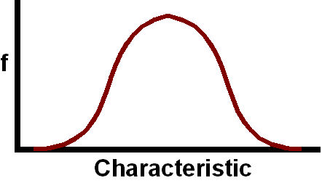
Interval Data in Normal Distribution
Mean, Median, and Mode

Slide 44
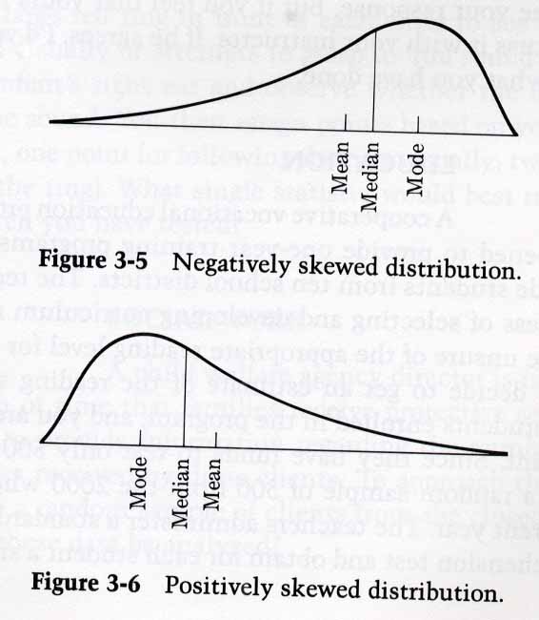
The effect of skew on average.
In a skewed distribution, the mean is pulled toward the tail.

Slide 45
Which average?
Each measure contains a different kind of information.
For example, all three measures are useful for summarizing the distribution of American household incomes.
In 1998, the income common to the greatest number of households was $25,000.
Half the households earned less than $38,885.
The mean income was $50,600.
Reporting only one measure of central tendency might be misleading and perhaps reflect a bias.
When dealing with skewed data, this takes some thought

Slide 46
Which average?
“Wal-Mart's average wage is around $10 an hour, nearly double the federal minimum wage. The truth is that our wages are competitive with comparable retailers in each of the more than 3,500 communities we serve, with one exception: a handful of urban markets with unionized grocery workers. Few people realize that about 74 percent of Wal-Mart hourly store associates work full-time, compared to 20 to 40 percent at comparable retailers. This means Wal-Mart spends more broadly on health benefits than do most big retailers, whose part-timers are not offered health insurance. You may not be aware that we are one of the few retail firms that offer health benefits to part-timers. Premiums begin at less than $40 a month for an individual and less than $155 per month for a family.”

Slide 47
BREAK

Slide 48
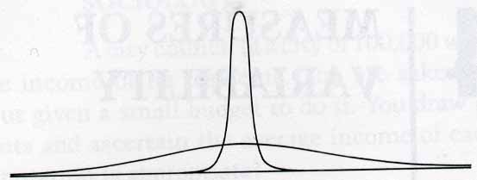
Measures of Variability
A single summary figure that describes the spread of observations within a distribution.

Slide 49
Measures of Variability
Range
Difference between the smallest and largest observations.
Interquartile Range
Range of the middle half of scores.
Average Deviation
Rough measure of the average amount by which observations deviate from the mean.
Standard Deviation
Rough measure of the average amount by which observations deviate from the mean. In standardized units of the normal distribution

Slide 50
Variability Example: Range
Las Vegas Hotel Rates
52, 76, 100, 136, 186, 196, 205, 250, 257, 264, 264, 280, 282, 283, 303, 313, 317, 317, 325, 373, 384, 384, 400, 402, 417, 422, 472, 480, 643, 693, 732, 749, 750, 791, 891
Range: 891-52 = 839
Mean: 371.6

Slide 51
Pros and Cons of the Range
Pros
Very easy to compute.
Scores exist in the data set.
Cons
Value depends only on two scores.
Very sensitive to outliers.
Influenced by sample size (the larger the sample, the larger the range).

Slide 52
Variability Example: Interquartile Range
Las Vegas Hotel Rates
52, 76, 100, 136, 186, 196, 205, 150, 257, 264, 264, 280, 282, 283, 303, 313, 317, 317, 325, 373, 384, 384, 400, 402, 417, 422, 472, 480, 643, 693, 732, 749, 750, 791, 891
Interquartile Range:
(35+1)/4 = 9
472-257 = 215

Slide 53
Variability Example: Interquartile Range
Note: If you have an even number of data points, you will get a fraction when dividing by 4
All you do is average to two numbers it falls between (for both the upper quartile and the lower quartile)

Slide 54
Pros and Cons of the Interquartile Range
Pros
Fairly easy to compute.
Scores exist in the data set.
Eliminates influence of extreme scores.
Cons
Discards much of the data.

Slide 55
Average Deviation
AKA MAD, AKA RAD
How far, on average are all the observations from the mean?
Task
Let’s say we have a data set of heights for a class (in inches)
60, 62, 72, 78, 66, 70, 71, 74, 81, 75, 65
Calculate the mean height
Then, find the difference between each height and the mean
Then, add those differences together and divide by the number of heights

Slide 56
Average Deviation
Subject | Height | Height - Mean
1 | 60 | -10.36
2 | 62 | -8.36
3 | 72 | 1.64
4 | 78 | 7.64
5 | 66 | -4.36
6 | 70 | -0.36
7 | 71 | .64
8 | 74 | 3.64
9 | 81 | 10.64
10 | 75 | 4.64
11 | 65 | -5.36
 | Mean = 70.36 | Mean = 0 (rounding)

Slide 57
Average Deviation
Subject | Height | |Height – Mean|
1 | 60 | 10.36
2 | 62 | 8.36
3 | 72 | 1.64
4 | 78 | 7.64
5 | 66 | 4.36
6 | 70 | 0.36
7 | 71 | .64
8 | 74 | 3.64
9 | 81 | 10.64
10 | 75 | 4.64
11 | 65 | 5.36
 | Mean = 70.36 | Mean = 5.24
AD = 5.24

Slide 58
Standard Deviation
Why do we use this?
Translates everything into units of the Normal Distribution so we can do a better job of comparing sets of data
Allows us to make generalizations about a population from a sample (which we get into later)

Slide 59
Standard Deviation
If you understand the Average Deviation, then you should be fine with the standard deviation
Instead of getting the absolute value of a difference (which gets rid of the – signs), you square the difference (which also gets rid of the – signs)
Then at the end, after you’ve figure out the mean of the (now squared) differences, you take the square root to get you back to the original units

Slide 60
Standard Deviation
Give it a shot
Using the same height data as before, calculate the standard deviation

Slide 61
Standard Deviation
Subject | Height | (Height – Mean)²
1 | 60 | 107.33
2 | 62 | 69.89
3 | 72 | 2.69
4 | 78 | 58.37
5 | 66 | 19.01
6 | 70 | .13
7 | 71 | .41
8 | 74 | 13.25
9 | 81 | 113.21
10 | 75 | 21.53
11 | 65 | 28.73
 | Mean = 70.36 | Mean = 39.50
 |  | Sq. Root = 6.29
S = 6.29

Slide 62
Standard Deviation
So what’s this used for? Example
Suppose you score 80 on a math exam and 70 on a sociology exam – on which test did you get the better score?
It depends – how did your scores compare to other scores on the tests?
We need to know: what was the average for each exam; and, how far above or below the average was your score
OK, let’s say the math test mean was 85 and the sociology test mean was 75 – which test did you do better on?
Again, it depends – suppose the range on the math test was 80-90 and the range for the sociology test was 0-150 – which test did you do better on?
The Standard Deviation solves this last problem – it tells us, in standard deviation units, how far a particular case is from the mean - in this example, the range gave us enough information – what if the range was 65 – 100?

Slide 63
Standard Deviation
Let’s try a comparison of two data sets
It’s obvious that the work is not well distributed at E-Z Care, but can we compare the two sets more precisely?
Calculate the SD for both sets
Patient Load per Day by Doctor in Two Clinics, Health City, Texas – 1990-1995
E-Z Care Clinic |  | Welrun Clinic
Doctor | Patients | Doctor | Patients
A | 10 | F | 28
B | 20 | G | 29
C | 30 | H | 30
D | 40 | I | 31
E | 50 | J | 32
 | Mean = 30 |  | Mean = 30

Slide 64
Standard Deviation
E-Z Care
Welrun

Slide 65
Pros and Cons of Standard Deviation
Pros
Lends itself to computation of other stable measures (and is a prerequisite for many of them).
Average of deviations around the mean.
Majority of data within one standard deviation above or below the mean.
Cons
Influenced by extreme scores.

Slide 66
Variance
Right before you got the square root while calculating the standard deviation, you had the Variance
S²
Needed to generate some other more advance statistics (might get to later)

Slide 67
Mean and Standard Deviation
Using the mean and standard deviation together:
Is an efficient way to describe a distribution with just two numbers.
Allows a direct comparison between distributions that are on different scales.

Slide 68
Normal Distribution
AKA Normal Curve, AKA Bell Curve, AKA Gaussian Distribution
It’s important because if something looks like it, we can say a lot about the data that is in it
Luckily it shows up everywhere
Bird feeder – on a fence – in the yard
Staircase
Old chair
Popcorn
Laughter
Driving
Anything that can start at nothing and is only limited by its own nature

Slide 69
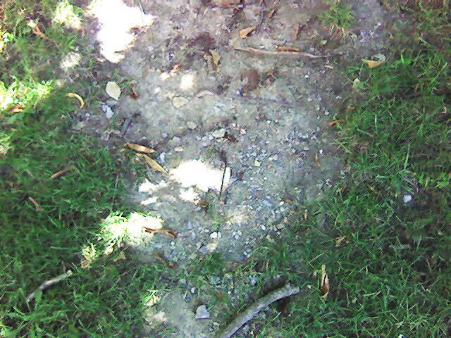
My trip to IPG

Slide 70
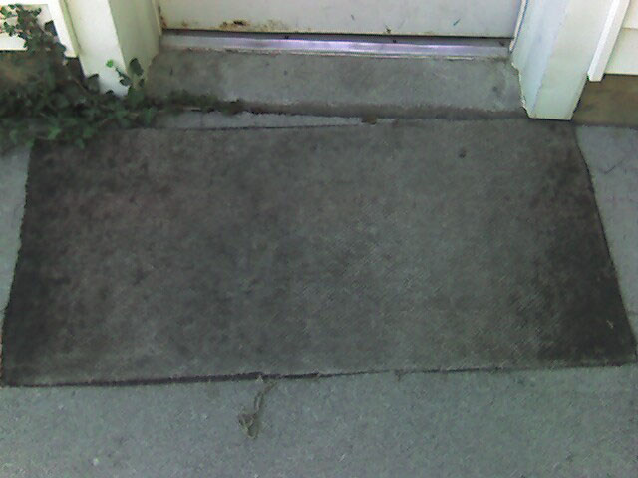
My trip to IPG

Slide 71
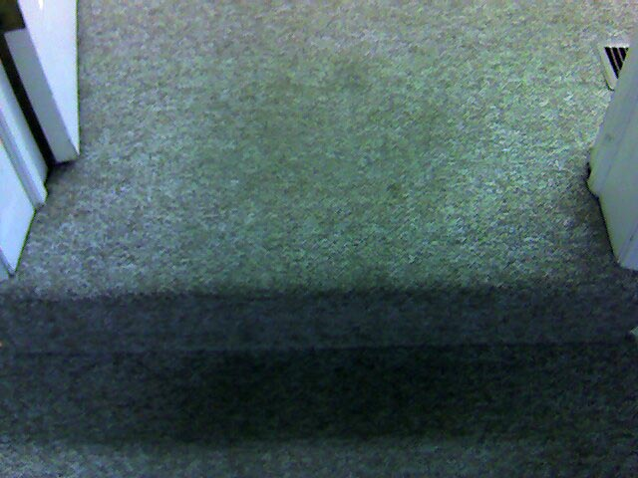
My trip to IPG

Slide 72
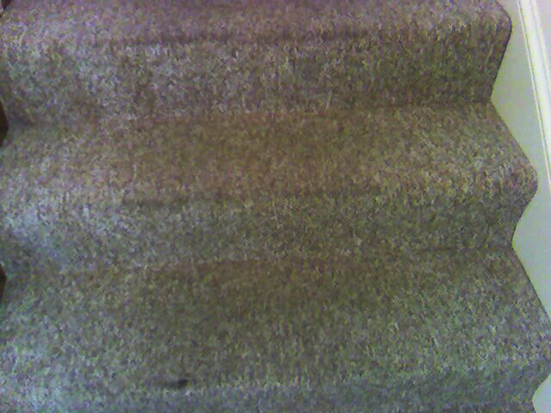
My trip to IPG

Slide 73
Normal Distribution
As seen before, this is what your basic normal distribution looks like
Symmetrical
Most values in the middle

Slide 74
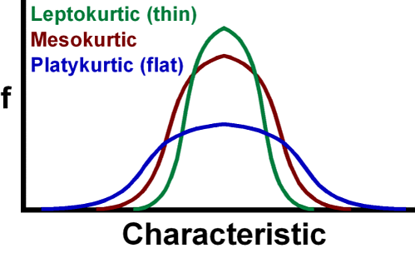
Normal Distribution
It can be skinnier or fatter
Taller or shorter
What we are working with is the “proportions” of the thing

Slide 75
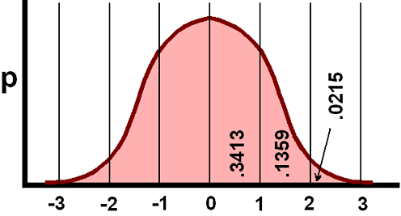
Normal Distribution
We use the proportions of the normal distribution to determine things about our data
If our data looks like this, then we can tell certain things about it just using the mean and standard deviation
About 68% of your data fall within 1 standard deviation
About 95% fall within 2
Almost all fall within 3

Slide 76
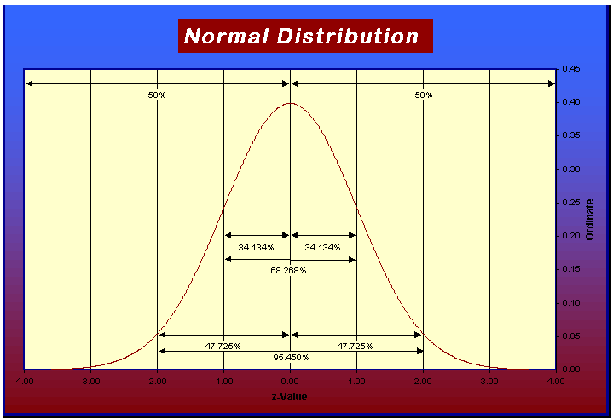

Slide 77
Relation to Standard Deviation
As soon as you have calculated the standard deviation, you know where 68% of the data are.
Take the time to multiply the SD by 2, and, voila, you know where 95% are
You now have a really good picture of the data, and , moreover, you can readily compare it to another set of data; or, make assumptions about a larger population

Slide 78
Relation to Standard Deviation
Going back to the two test example
We now know not only that E-Z Care has a larger spread around its mean than Welrun Clinic, but also that roughly 68% of doctors at E-Z Care see about 16-44 patients a day, while 68% of doctors at Welrun see about 29-31 patients a day
If I were a doctor looking for a job, this would be very useful information

Slide 79
Z-Score
Sometimes, you want to compare scores from two or more distributions, and you want to be very specific about it
Just knowing that one score is above 1 standard deviation is not enough (what if they both are?)
Easy enough – now that you have figured out what the standard deviation is, it is easy to figure out where any single score is in “standard deviation units”
1. Find out how far the point is from the mean (keep the signs)
2. Divide by the standard deviation

Slide 80
Z-Score
Now you know “how many” standard deviations that score is above or below the mean
Can accurately compare two or more scores
Also, you can accurately tell “where” a single score falls in its distribution
How good did you do on the test compared to others in the class?
For this , we use the “normal curve table” in the back of any stats/methods book (or a computer)

Slide 81
Z-Score
Once again, let’s try one
You have two tests you are trying to compare. One test has a mean score of 100 and a SD of 10, the other 750 and 100, respectively
How does a score of 75 on the first test compare with a score of 600 on the second?

Slide 82
Z-Score
First Test
Second Test
So what can we say? Who did worse? By about how much?
We can actually answer that question precisely
Look at Z-Score sheet

